Slide 1
BUAN 6382 Project
By Yash Salvi

Slide 2
Problem Statement
The campus placement process is a crucial bridge between academic institutions and the job market, yet it often lacks consistency, efficiency, and predictability. Recruiters and placement cells must manually evaluate large volumes of student data, while students face uncertainty due to varying selection criteria across companies. This creates a need for a data-driven solution that can support decision-making and improve the effectiveness of campus recruitment.
This project aims to develop a neural network model that can predict the likelihood of a student being selected in campus placements based on academic performance, skillsets, test scores, and other relevant features. By analyzing historical placement data, the model will learn to identify patterns and key predictors of selection success. The goal is to assist placement officers in screening candidates more efficiently and help students understand their strengths and areas of improvement, ultimately making the campus recruitment process more transparent, objective, and effective.

Slide 3
Data description
No. | Feature | Type | Description
1 | Gender | Categorical | Gender of the candidate.
2 | Secondary Education % | Numerical | Percentage in secondary education (10th grade).
3 | Secondary Education Board | Categorical | Educational board for secondary education.
4 | Higher Secondary Education % | Numerical | Percentage in higher secondary education (11th–12th grade).
5 | Higher Secondary Education Board | Categorical | Educational board for higher secondary education.
6 | Higher Secondary Education Stream | Categorical | Academic stream in higher secondary (e.g., Science, Commerce, Arts).
7 | Undergraduate Degree % | Numerical | Percentage in undergraduate degree program.
8 | Undergraduate Degree Type | Categorical | Type of undergraduate degree (e.g., B.Sc, B.Tech, B.Com).
9 | Work Experience | Categorical | Indicates whether the candidate has prior work experience.
10 | Employability Test % | Numerical | Score in employability test conducted by the institution or employer.
11 | MBA Percentage | Numerical | Percentage obtained in the MBA program.
12 | MBA Specialization | Categorical | Area of specialization in MBA (e.g., Marketing, Finance, HR).
13 | Placement Status | Categorical | Target variable: indicates whether the candidate was placed or not.

Slide 4
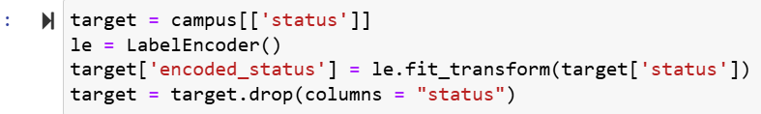
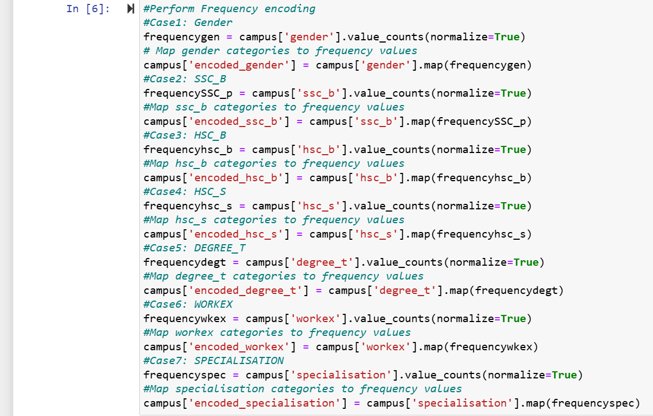
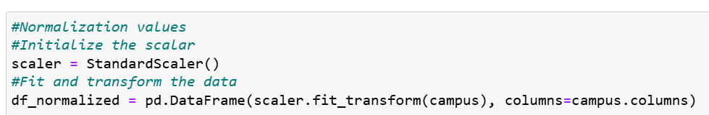
Data pre-processing
Perform frequency encoding on (gender, ssc_b, hsc_b,hsc_s,degree_t, workex and specialization) to improve the performance of the model.
Perform label encoding on status column to convert categorical data into numerical data.
Data is normalized to improve the performance of the model.

Slide 5

Build feed-forward neural network model
Hyperparameters used: learning_rate, number of layers, number of neurons, activation function and dropout.
Architecture:
Input layer: 12 predictors
Hidden layer: 3 hidden layers (activation = relu, first layer =256 neurons, second layer = 192 neurons, third layer = 96 neurons )
Dropout: Randomly disables 30% of neurons during training to reduce overfitting
Output layer (activation = sigmoid, Output layer for binary classification (placement: yes/no))

Slide 6
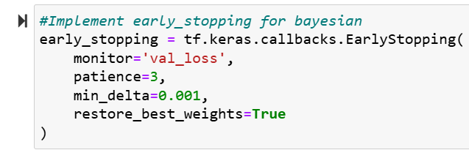
Training the model
Optimization techniques used:
Hyperparameter tuning: Randomsearch, Bayesian and Hyperband tuning techniques were used.
Adam(Adaptive Moment Estimation) was used to optimize the model performance.
Regularization techniques used:
Early stopping technique and dropout technique was used.
Mini batch technique is used.

Slide 7
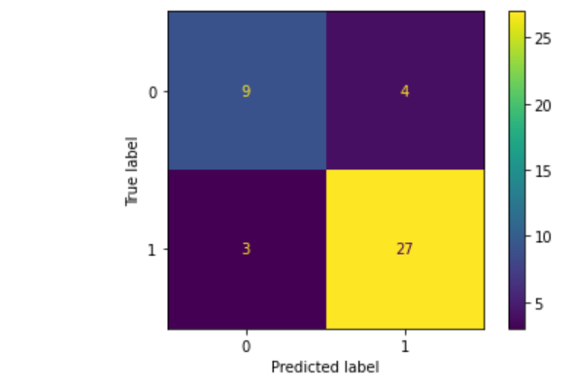
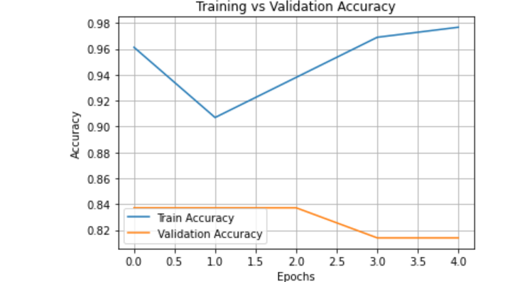
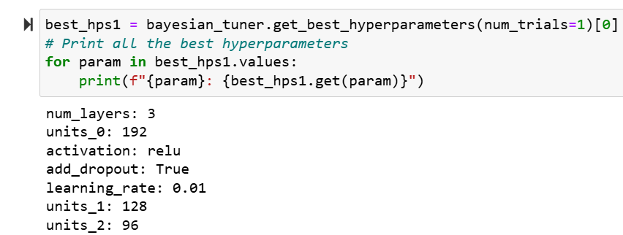
Model evaluation
The data is split into 60% training data, 20% validation data and 20% test data.
Two models were created based on Bayesian optimization and Hyperband optimization. The best performing model is the Bayesian model with 3 hidden layers, learning rate of 0.01, hidden layer activation function is relu, first hidden layer has 192 neurons, second hidden layer has 128 neurons, third hidden layer has 96 neurons and dropout is used.
Accuracy: 83.7%
Precision: 87.1% Recall: 90.0%
F1 score: 88.5%
Train accuracy: 90.70%
Validation accuracy: 83.72% Test accuracy: 83.72%
Loss: 39.67%

Slide 8
Challenges and Solutions
Challenges faced is the limited availability of data. Years of work experience, specialized courses taken and extracurricular activities can drastically affect an individual’s likelihood to be placed in a company. Hyperparameter tuning was difficult because of the large training time with different hyperparameters.
Solutions that I used is the early stopping technique to stop epochs at the lowest validation loss to select the best parameters. Lastly, I used mini batch method to accelerate training time.

